Slide 1
FastChi
-The Parallelized Fast Style Transfer toward Chi-chi video-
0656011 Sunner Li
0656126 Liu Yen
0656605 Peter Chuang

Slide 2
Outline
Introduction
Problem statement
Proposed solution
Evaluation
Related work
Conclusion
Contributions of each member

Slide 3
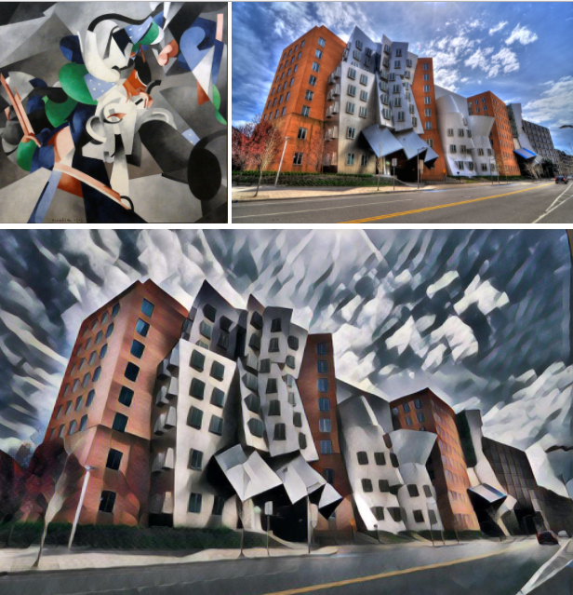
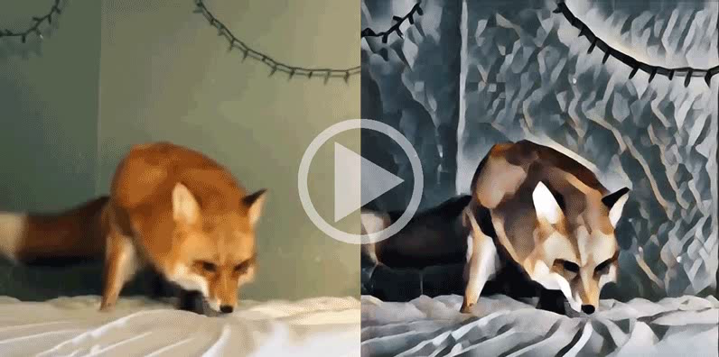
Introduction
Style transfer for video
Style transfer for image

Slide 4
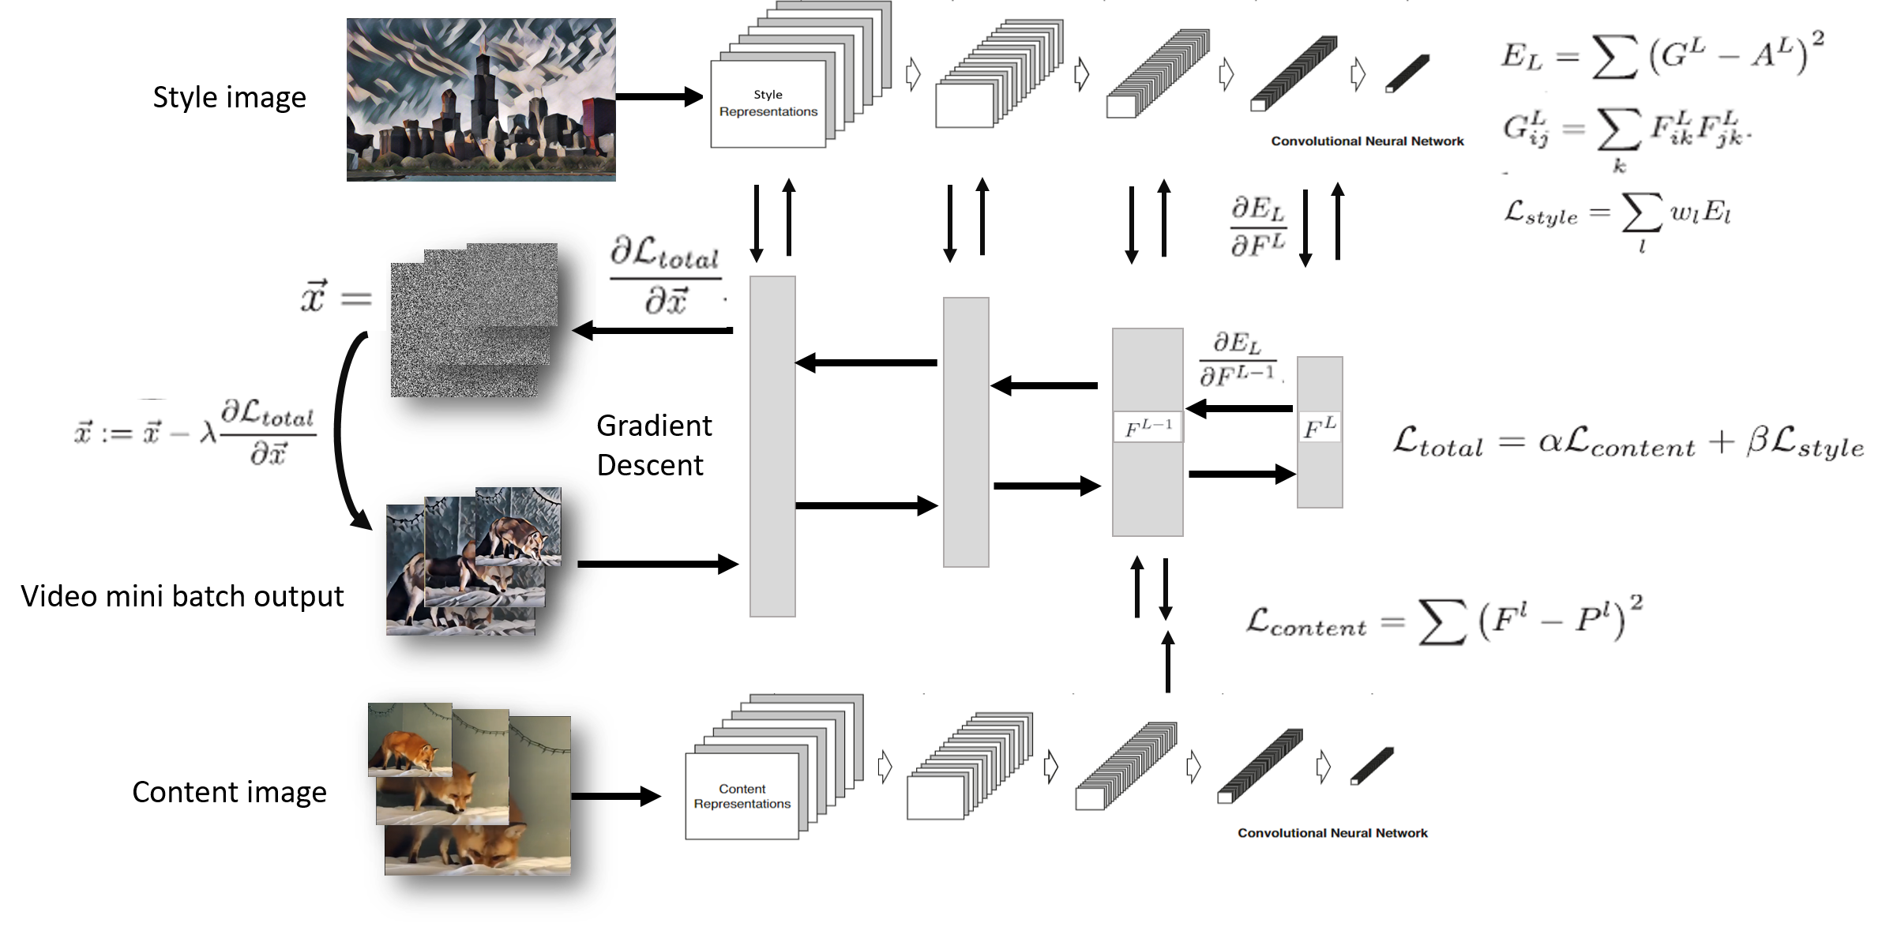

Slide 5
Problem statement
Changes made after the proposal:
At first we decided to speed up the progress of the transformation, but we found that the original network architecture is too large.
Parallel tools from joblib to multigpu

Slide 6
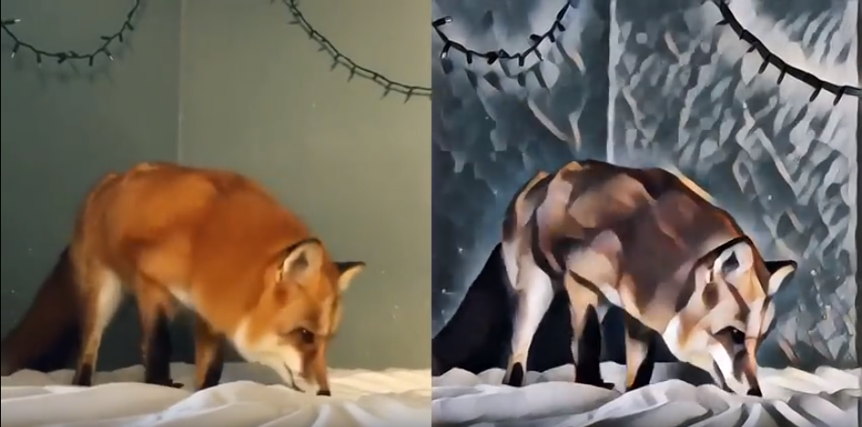
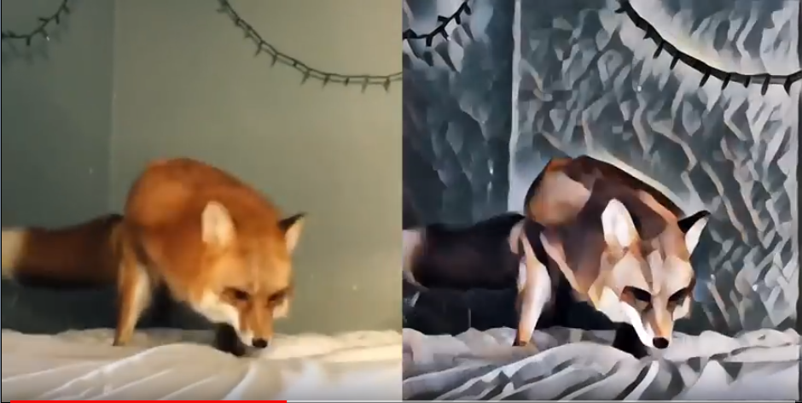
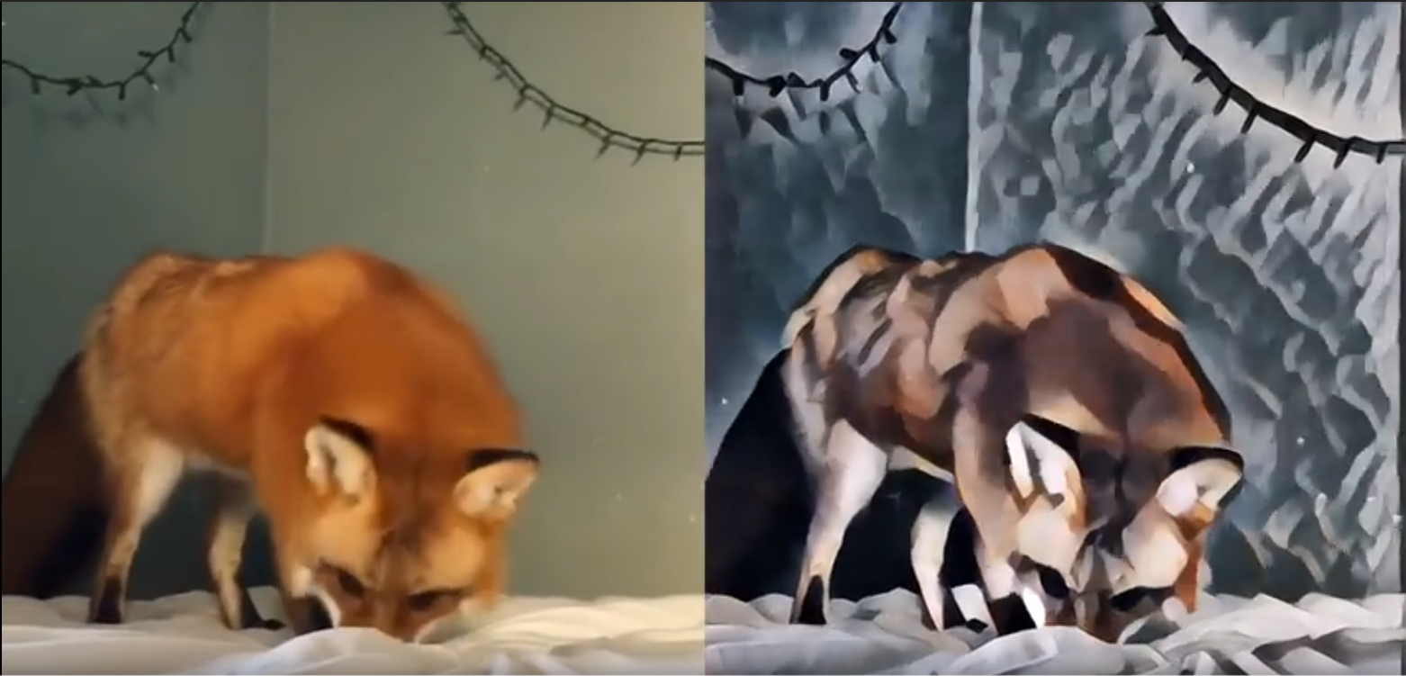
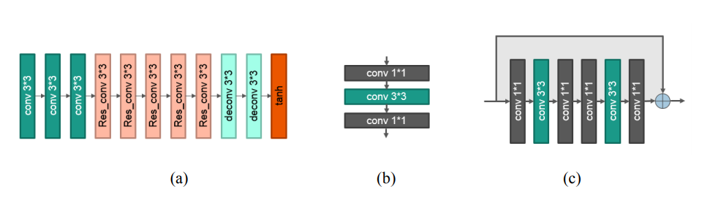
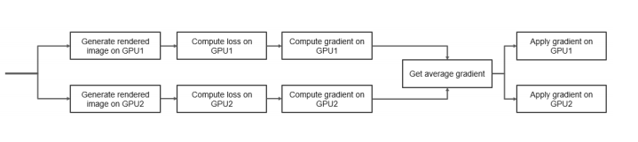
Proposed solution : RAA 3 Steps
Reduce Parameters
Accelerate Training Time
Accelerate Transforming Time
Notes:
Tansforming 缺圖

Slide 7
Evaluation

Slide 8
Related work
[1] Leon A. Gatys, Alexander S. Ecker, and Matthias Bethge, “Image Style Transfer Using Convolutional Neural Networks,” In 2016 Computer Vision and Pattern Recognition (CVPR), Las Vegas, Nevada, USA, 27-30 June, 2016, pp. 2414-2423.
[2] Dmitry Ulyanov, Andrea Vedaldi, and Victor Lempitsky, “Instance Normalization: The Missing Ingredient for Fast Stylization,” arXiv: 1607.08022v2 [cs.CV], Sep. 2016.
[3] Justin Juhnson, Alexandre Alahi, and Li Dei-Dei, “Perceptual Losses for Real-Time Style Transfer and Super-Resolution,” arXiv: 1603.08155v1 [cs.CV], March 2016.

Slide 9

Conclusion

Slide 10
Conclusion

Slide 11

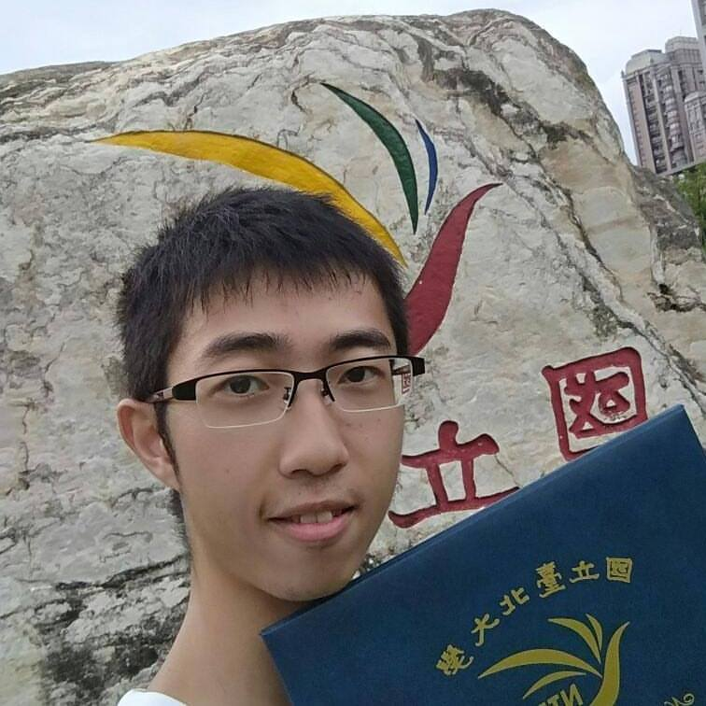
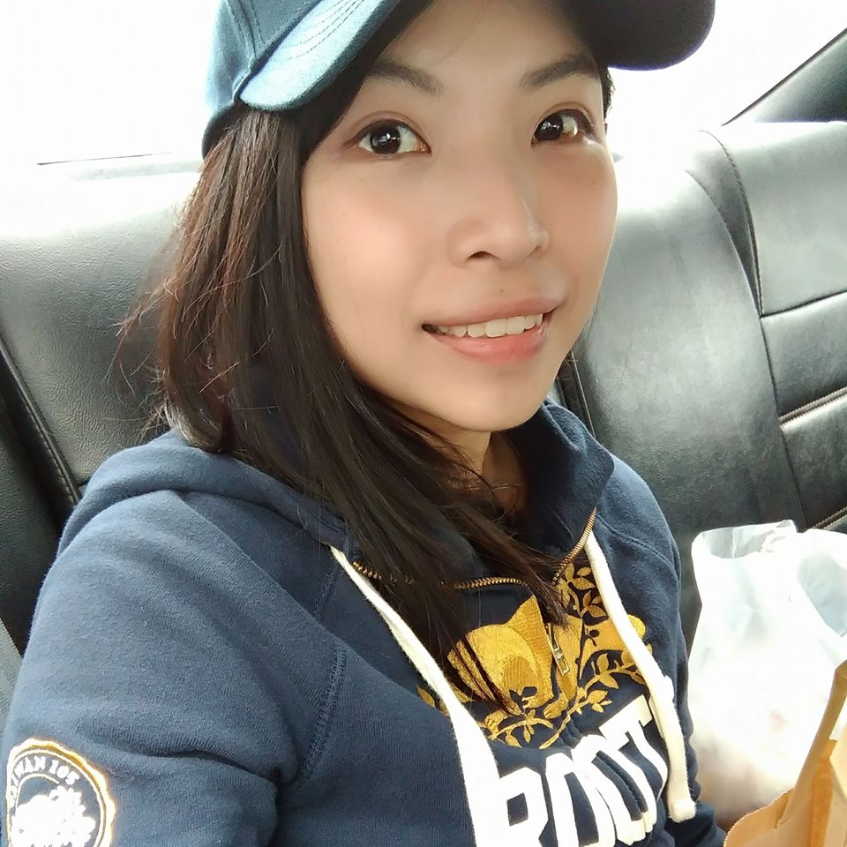

Contributions of each member

Slide 12
Q&A

